Slide 1
SHIKSHA EKIKARAN
WEEK
2
INTEGRATION OF SCHOOL, HIGHER AND TECHNICAL EDUCATION IN INDIA

Slide 2
FUNCTIONAL REQUIREMENTS (updated)
Adding to last week, the website is mainly to show stats and data about educational policies around the country.
Showing the stats on students’ progress, the overall development of a location, and knowing about what students are opting for after every educational level’s completion.
Constant updates so that the governing bodies can know what policies to implement.
Able to filter data to get better results, such as state and central, male and female, normal and handicapped, etc.,

Slide 3
PROCESS
The educational institutions register themselves on our website.
After they register themselves, an admin will have to validate whether the registration is true or fake.
This is done by checking their Institution’s government recognition number, and the history of the institution.
Once the institution is verified, they get their special id, this would be different for each institution.
They are expected to log in at the end of every quarter of an academic year and upload their data(mostly in the form of xlxs).
This data would be shown in form of graphs and charts.

Slide 4
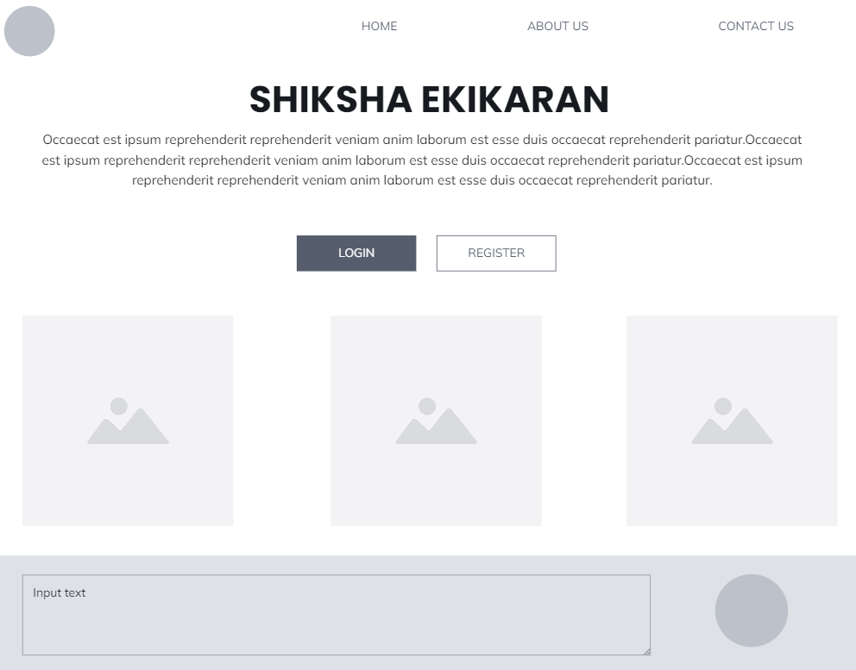

Slide 5
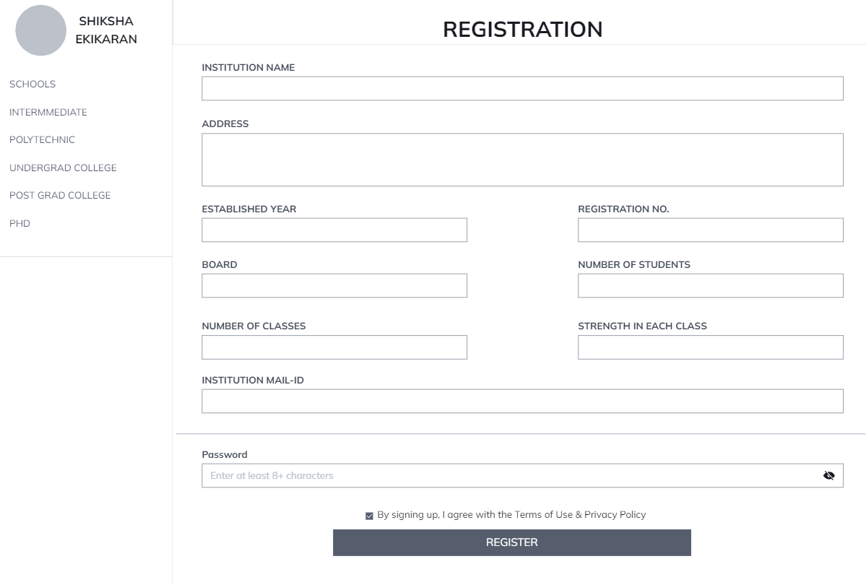

Slide 6
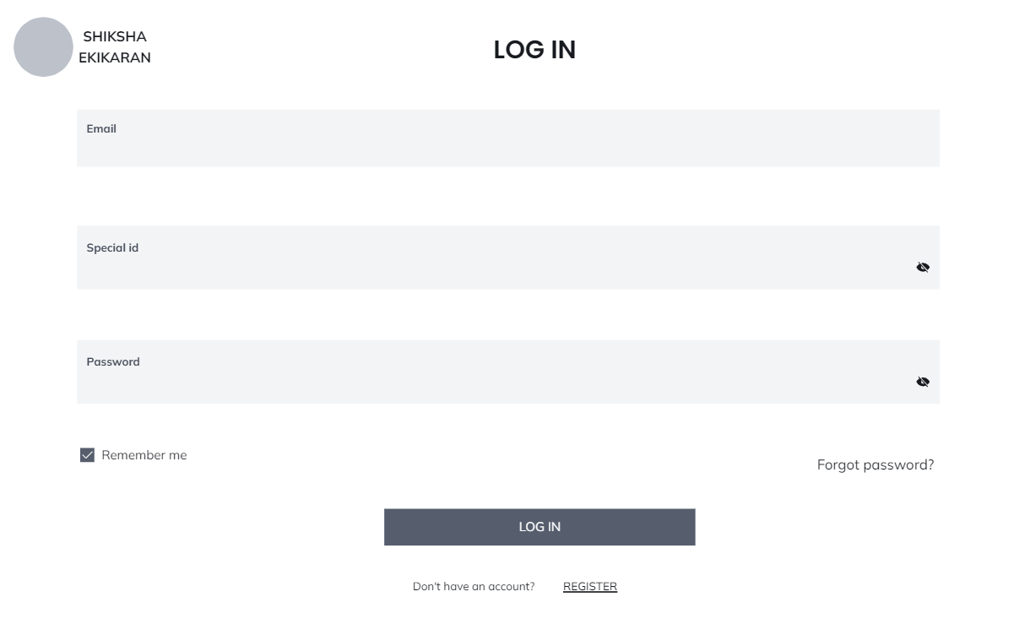

Slide 7
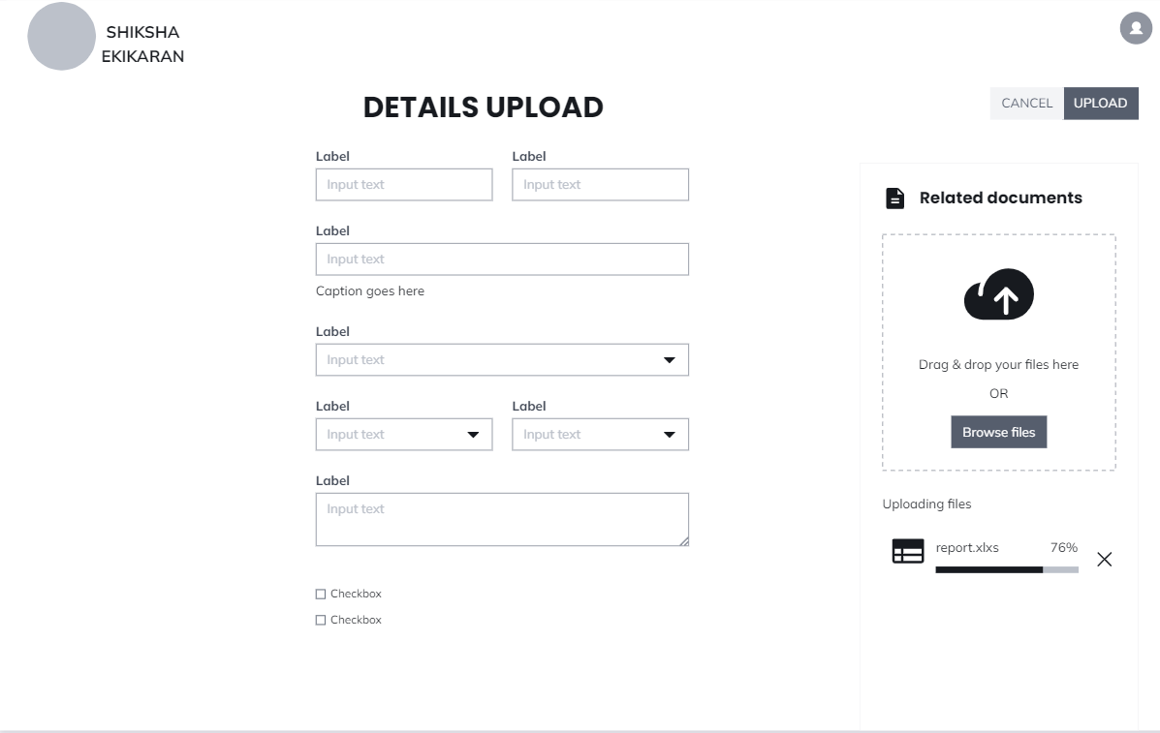

Slide 8
